Slide 1
Better Weather
Noah Sternberg - CSC425 Final Project
Notes:
Introduce self
Explain that I chose to make BetterWeather for my final project, then begin presentation with slight pause.

Slide 2

I Hate Weather Apps.
A lot.
Notes:
Read slide word for word.
Transition with “and I hate weather apps for one main reason:”

Slide 3
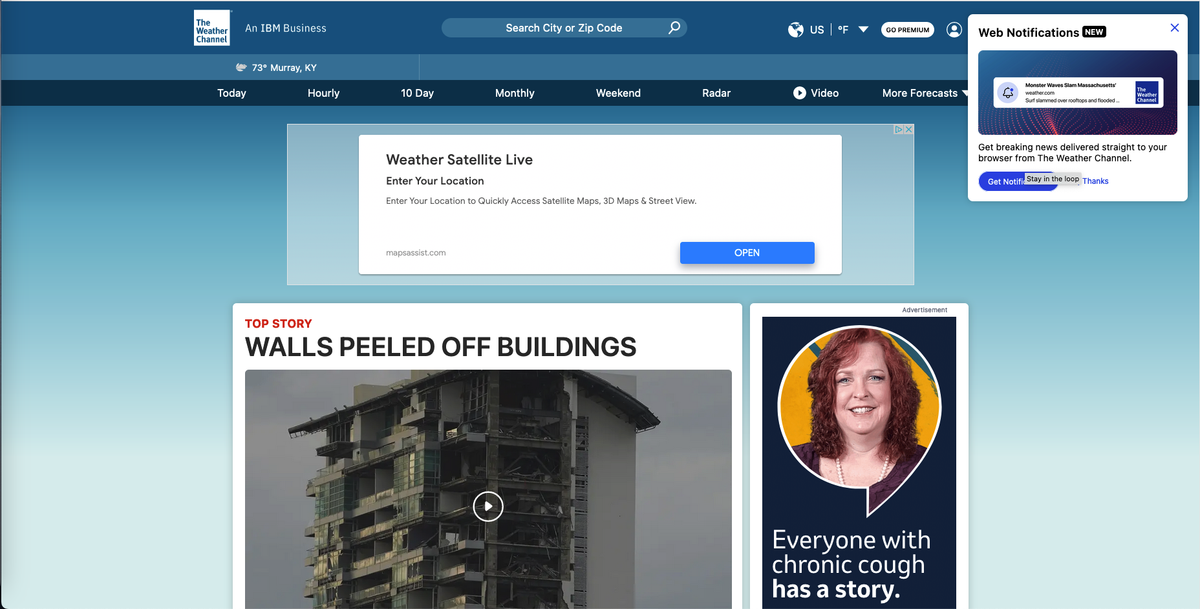
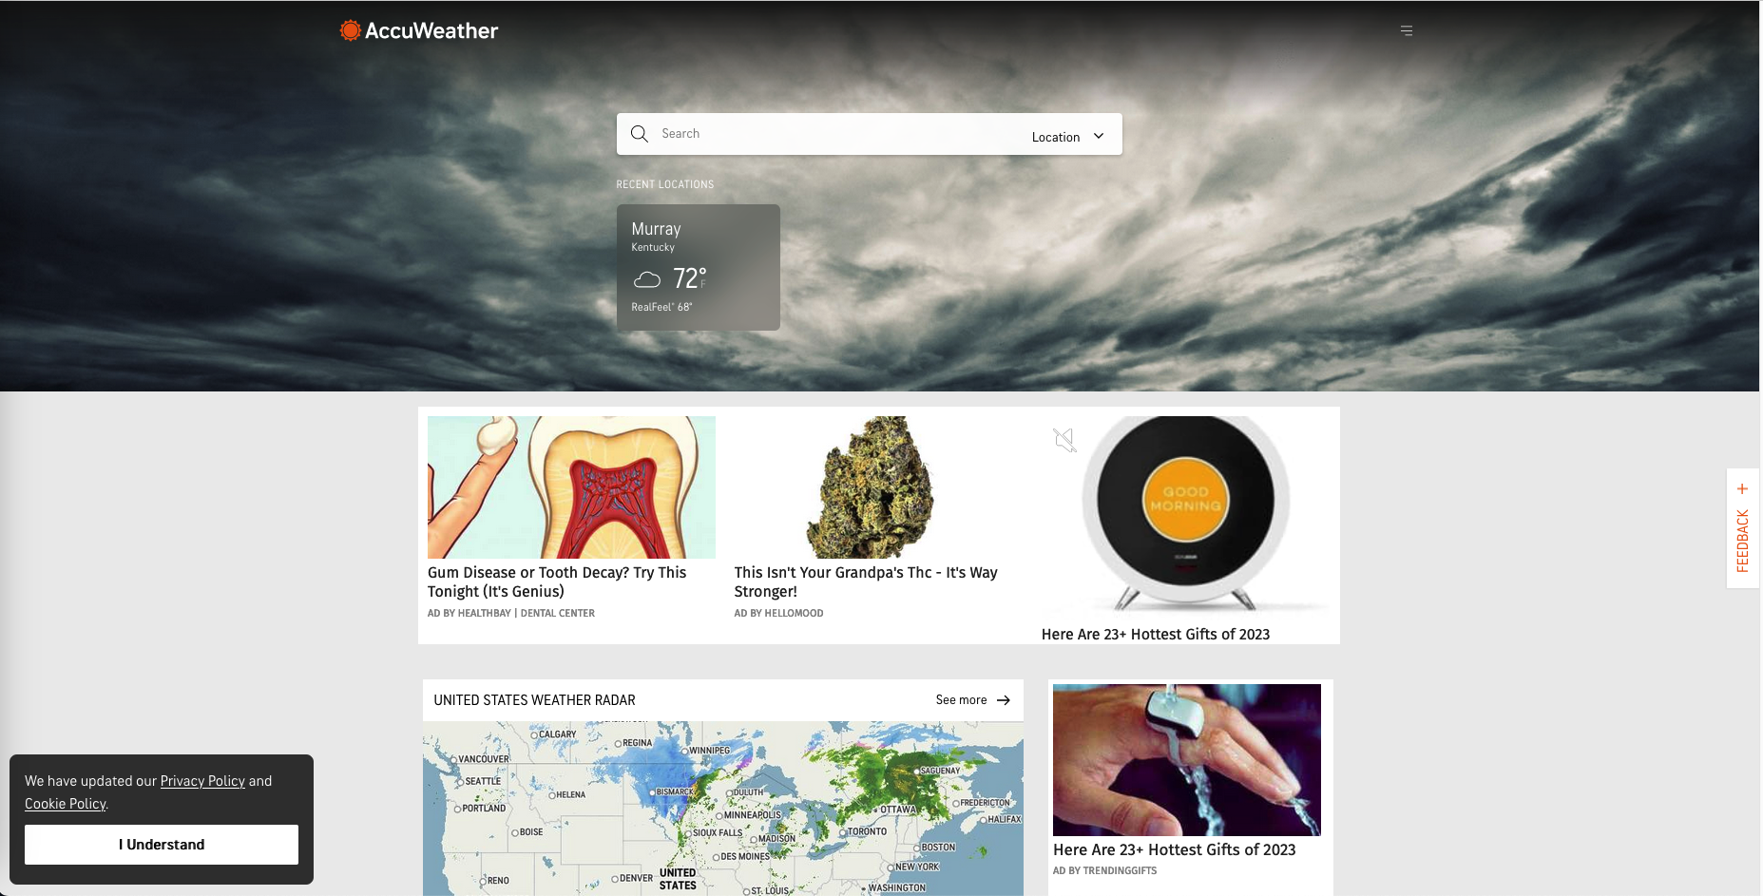
Why?
Notes:
“Where’s the weather”
Talk about the adverts on the screen before the weather
Transition with “thats why I made this app with one thing in mind:”

Slide 4

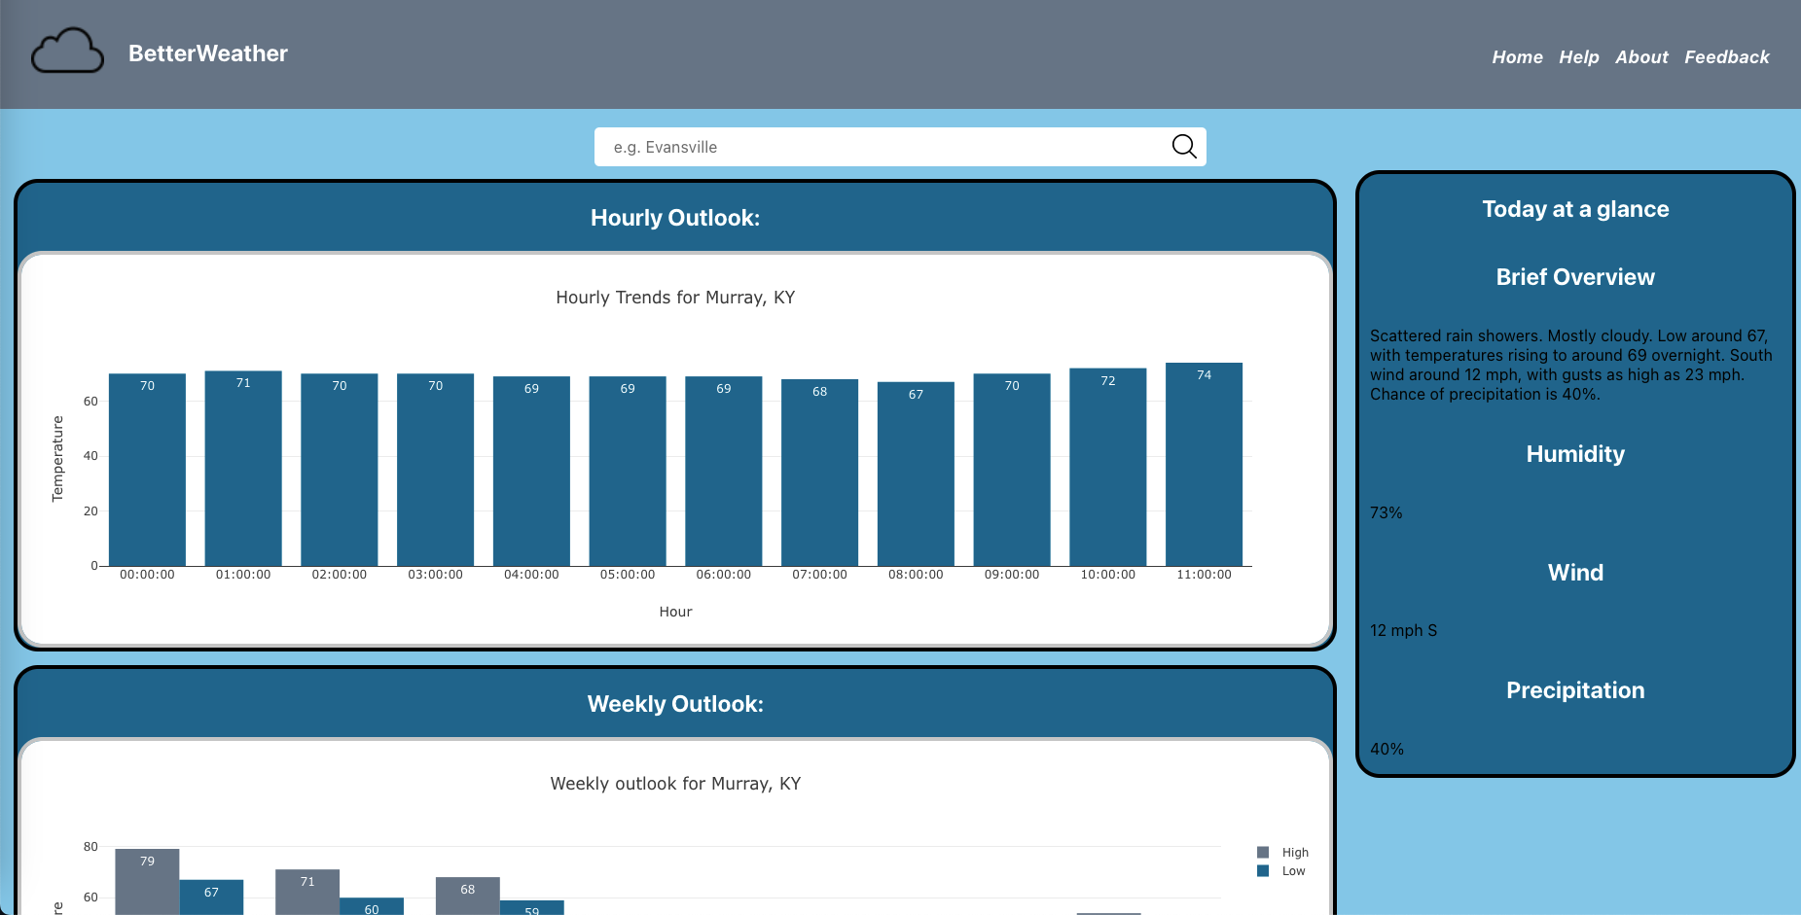
Weather, First and Foremost
Notes:
Say the tag line
Transition with “before the demo, let’s do a technical overview”

Slide 5




Technical Overview
Front End
Back End
Web Services
Cloud Services
ReactJS with SCSS
National Weather Service’s Free RESTful API
National Weather Services Free RESTful API and OpenWeatherMap’s GeoCoding RESTful API
None!
(Didn’t need one)
Notes:
Explain why there are no cloud services
Explain why I didn’t need a custom back end (starting to use Spring Boot with Java, decided it wasn’t needed)

Slide 6



Behind the Scenes
Planning
Version Control
CI/CD
JIRA
Git and GitHub
GitHub Actions
Notes:
Explain why there are no cloud services
Explain why I didn’t need a custom back end (starting to use Spring Boot with Java, decided it wasn’t needed)

Slide 7
Demo

Slide 8
It’s Free, but if it wasn’t …
Option 3
Option 2
Option 1
Ads, with a paid opt-out (I refuse to use invasive ads)
Offer some features behind a paid upgrade
Offer optional financial support (“buy me a coffee”)
Notes:
Three levels of optional financial options

Slide 9
Thank you for your time!

